Slide 1

SAP Build Training for Corporate Professionals
DAY-8
www.anubhavtrainings.com

Slide 2


DISCLAIMER
The training content and delivery of this presentation is confidential, and cannot be recorded, or copied and distributed to any third party, without the written consent of Anubhav Trainings

Slide 3
Agenda
Calling Actions
Calling actions to load data
Integrate Table
Show table in form
Add Script Task
Create Complex logic using Script
Parallel branch
Working with parallel branch

Slide 4

Build Process Scenario 2 – Script Task
Alex is a manager working in one of the top IT Company. He is being approached for every shopping cart request created by employees reporting to him.
His key requirements are:
Design a process to automate the shopping cart for products available at the global API of our organization
As part of the input user can request a discount % to each of the product
The approval should be sent parallelly to VP and manager with a table showing products and total value with discount
Once both the manager and VP approves the requests, an approval email will be sent to requestor
If VP do not take action on shopping cart request for more than 5 minutes, we should proceed w/o approval

Slide 5
Steps
Create a destination for the API (service) we want to call
Create an action using the destination and choose a call for getting products
Observe the output and data types if match with result
Go to control tower and destinations and import that destination build BPA
Go to test and check the action by calling API, if needed change data type to fix error
Once testing done, save, release and publish the action
-------
Create a process
Define the input parameter and create api trigger
Add a action connecting to API action for products and system creates a list data type for us
Use the datatype to create variable for holding all data, total, discountedAmount
Map the input and output with action, input process and custom variable
Add script task to calculate total and discount amount
Add parallel branch to execute approval step for manager and VP (binding)
Create deadline monitoring for VP approval form

Slide 6
//get all the data in a variable
var products = $.context.action_get_Alphabetical_list_of_products_1.result.value;
//set default as 0 for total
$.context.custom.totalamount = 0;
///loop on all products data
products.forEach(function (record) {
$.context.custom.totalamount += Number(record.UnitPrice);
});
var discount = $.context.custom.totalamount * ($.context.startEvent.discount) / 100;
$.context.custom.discountedamount = $.context.custom.totalamount - discount;

Slide 7
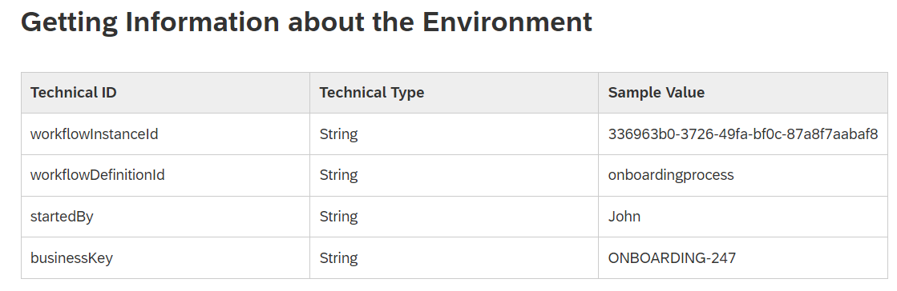
Script task
Script task – we can write code to manipulate the process context, call the process apis at runtime (JS code)
We can also modify the context data during runtime of script task using - $.context.objectname
There are also standard context variable
Cheat sheet workflow expressions
https://help.sap.com/docs/WORKFLOW/e157c391253b4ecd93647bf232d18a83/9f91b1c0fac3414d9cba1015dea381f1.html

Slide 8
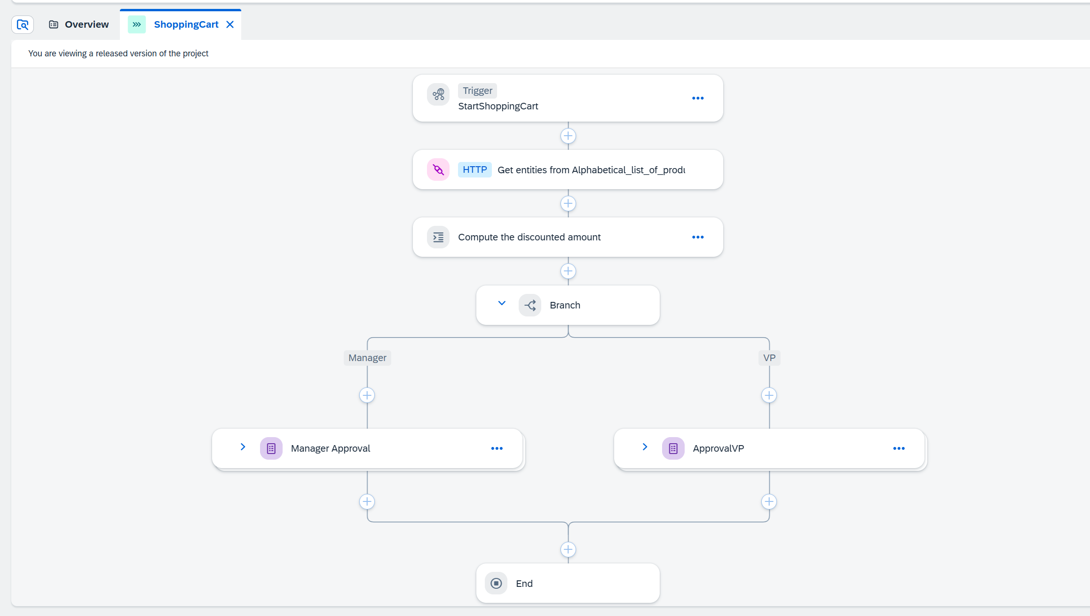

Slide 9
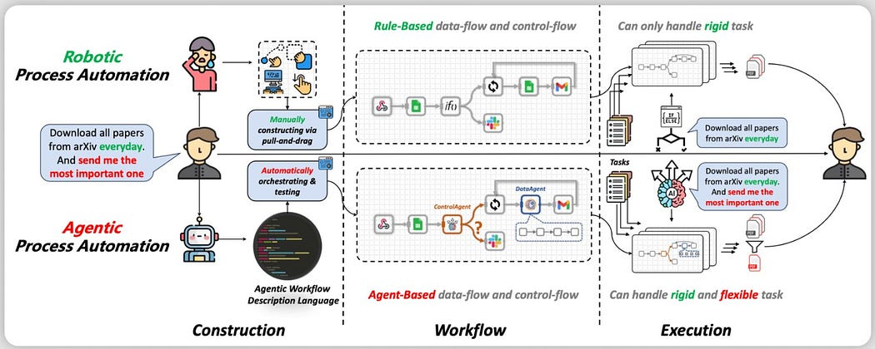
iRPA
Robotic Process Automation (RPA) has been used to automate mundane and complicated business processes. RPA uses software robots to automate the boring stuff done by humans such as data entry, transaction processing, web scrapping and so forth.

Slide 10
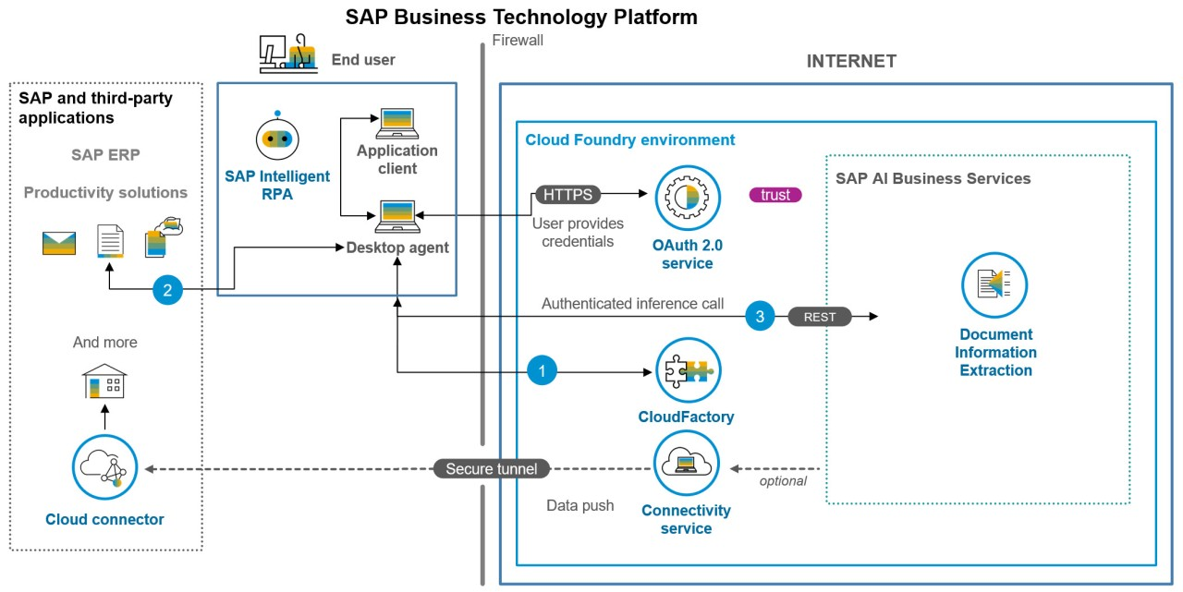
The Design

Slide 11
What is iRPA Desktop agent?
The Desktop Agent is a component of SAP Build Process Automation that is installed locally on user desktops. It executes automation projects that launch and run applications of various kinds, reads information from screens, enters data, clicks options, and processes data.
Projects are assigned to tenants running on a Desktop Agent. You can see what your Desktop Agent is doing at all times thanks to the convenient system tray, or Systray, that is always accessible while your Desktop Agent is ready or active.
When it is installed, the Desktop Agent is configured to start at Windows logon automatically. You should not change this setting because your Agent might be assigned background (unattended) jobs at any time.
The very first time you launch the Desktop Agent on your workstation, you will be prompted to log in. If you are unsure of your login details, please ask an administrator.

Slide 12
Steps to configure Desktop agent
Download the Desktop agent (RPA agent) 3.0 – https://tools.hana.ondemand.com/#cloud
Added the agent to control tower settings
Register the agent in the environment
Set the mode as unattended mode
Enable the browser plugin with allowed settings in chrome
Guide for desktop agent 3
https://help.sap.com/doc/dd104fba73bd4ac19abf88080ff88512/Cloud/en-US/1d297d6d159346dcb94928b90c019b9e.pdf
If you plan to use productive Desktop agent, follow the guide below (permission for SAP software downloads)
https://developers.sap.com/tutorials/spa-setup-desktop-3-0-agent..html

Slide 13

What We Did
Let’s Summarize
www.anubhavtrainings.com

Slide 14
www.anubhavtrainings.com
Thank You
End of Day 6
www.anubhavtrainings.com

Slide 15



We’re committed to empower you to be
#FutureReady
through powerful training solutions.
We build the workforce of the future.
250+
Corporate Clients
30,000+
Learners Trained
25000+
Learners Placed
FREE WEBINARS
Sign up for free webinars with industry experts every fortnight!
Enroll Now!
Contact us today!
https://anubhavtrainings.com

